Slide 1
Dallas Food Inspection (Part 1&2)
Submitted by
Aditya Kanala
Sameer Nimse
Yamini Manral
Ankita Patil

Slide 2
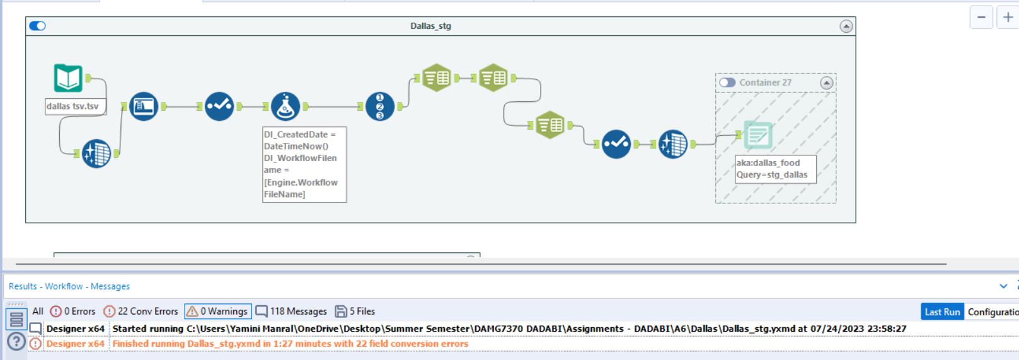
Alteryx workflows for staging table

Slide 3
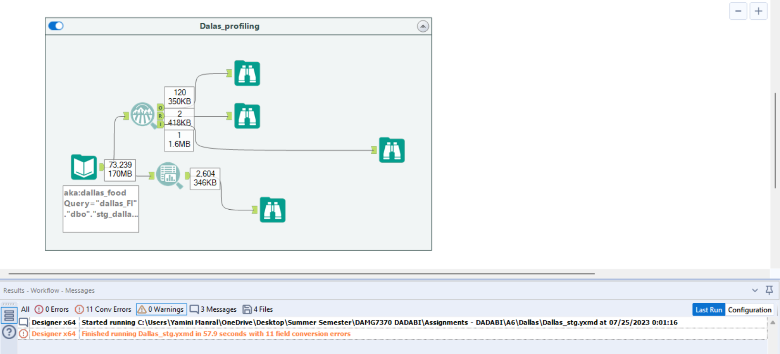
Alteryx Workflow for Data profiling

Slide 4
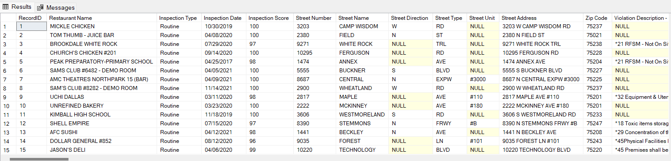
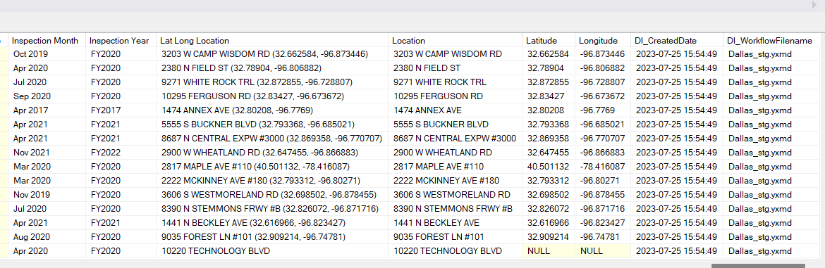
Staging table in SSMS

Slide 5
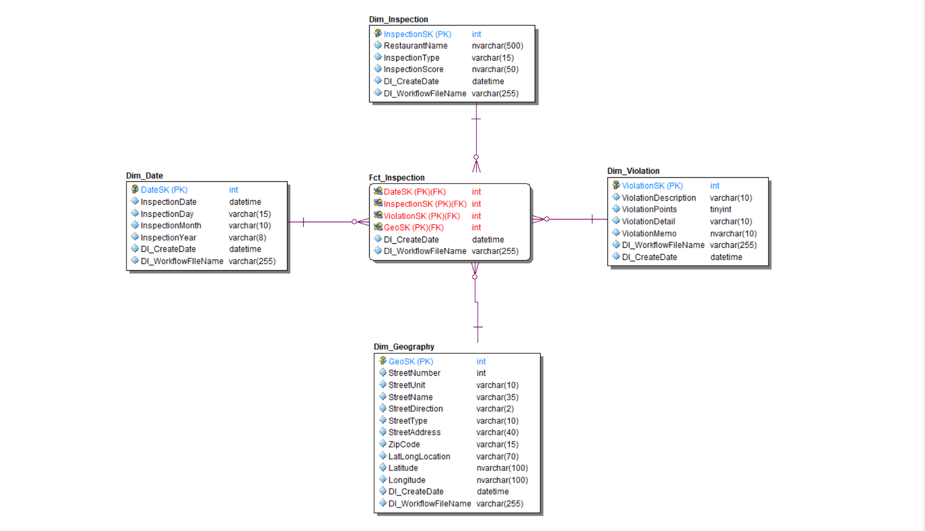
ER Studio Data Model

